Slide 1
First Sprint Recap
Group 4: Microwave Tracking Ground Station

Slide 2

Introduction
What’s our Product?
We are building a satellite ground station intended for tracking and receiving data from S-Band satellites within range of Embry-Riddle.
Why is it important?
It provides valuable data to customer.
It provides a link between Earth and space.
Without a ground station, a satellite is just space junk.

Slide 3
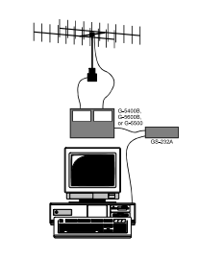
Design Requirements
Hardware
Should use COTS (consumer off the shelf) components to reduce complexity
Positioner unit speed
Rotation time (approx.): Elevation (180°): 65 sec. ± 20%
Azimuth (360°): 60 sec. ± 20%
Antenna beam width </= 3.38 degrees
Software
User-Interface written in python
Operates in the windows OS
Positioner controller utilizes Arduino
Communications
Operate in S-Band freq. Range (2.3GHz - 2.7GHz)
Notes:
Lee - Hardware

Slide 4
Software
Table of satellites we want to track
Can be updated anytime by customer
Rating/preference system to determine which satellite to choose from database
GUI will display ground station pointing towards satellite
Elevation + Azimuth angles
Satellite being tracked
Data will be displayed on a menu
Logged in file for customer use

Slide 5
Hardware
AutoCad Design
Positioner
Base Structure
Receiver Antenna
Antenna Azimuth-Elevation Rotators & Controller
Computer Control Interface for Antenna Rotators
Software Defined Radio
Ground Station Mount
Positioner Unit
Front-End Filter
Circular Polarization Adjusters

Slide 6
Safety Constraints/Industry Standards
The system must be mounted at all times during operation.
Structure must withstand blowing wind gusts no greater than 120mph.
Structure must withstand rain no greater than an IP44 rating.
Structure height must not exceed the MicaPlex roof level per FAA requirements.
Electrical system shall be ground properly through provided grounding wires.
System must reduce RF emissions in accordance with FCC regulations.
Students will not have access to the MicaPlex Roof following FAA and DHS guidelines

Slide 7
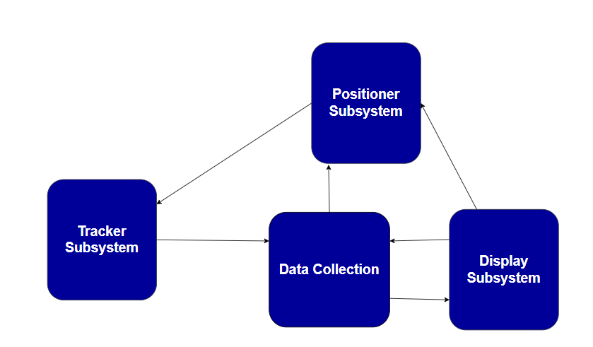
System Architecture

Slide 8
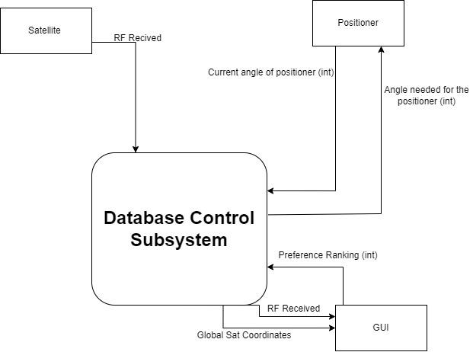
Database Subsystem Level 0 Data Flow Diagram

Slide 9
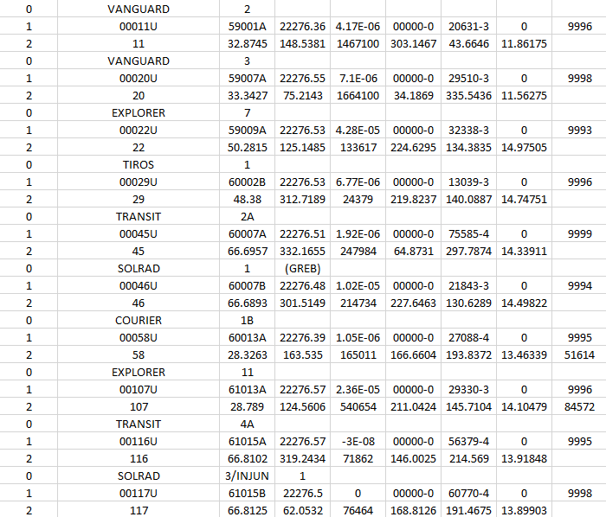
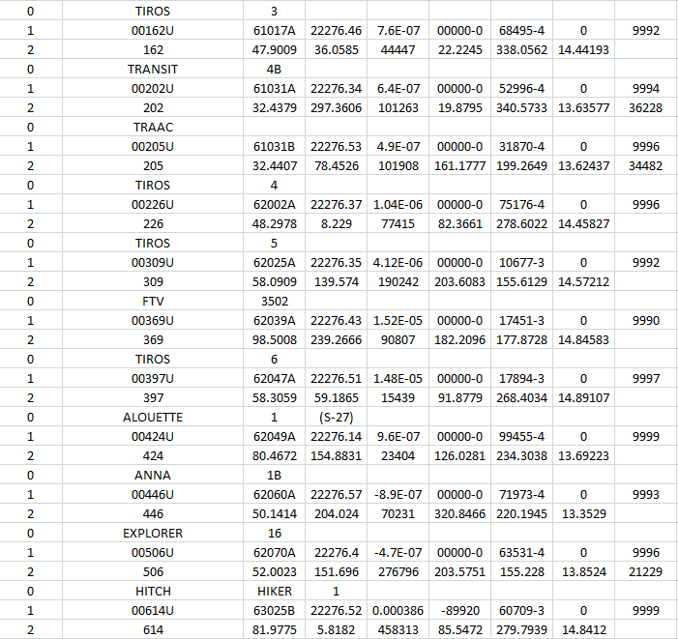
Satellite Table
Notes:
Lee

Slide 10
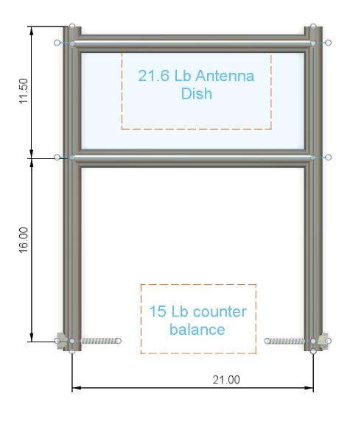
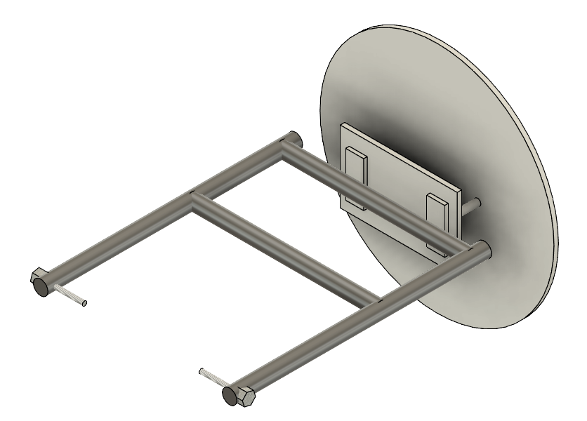
AutoCad Design

Slide 11
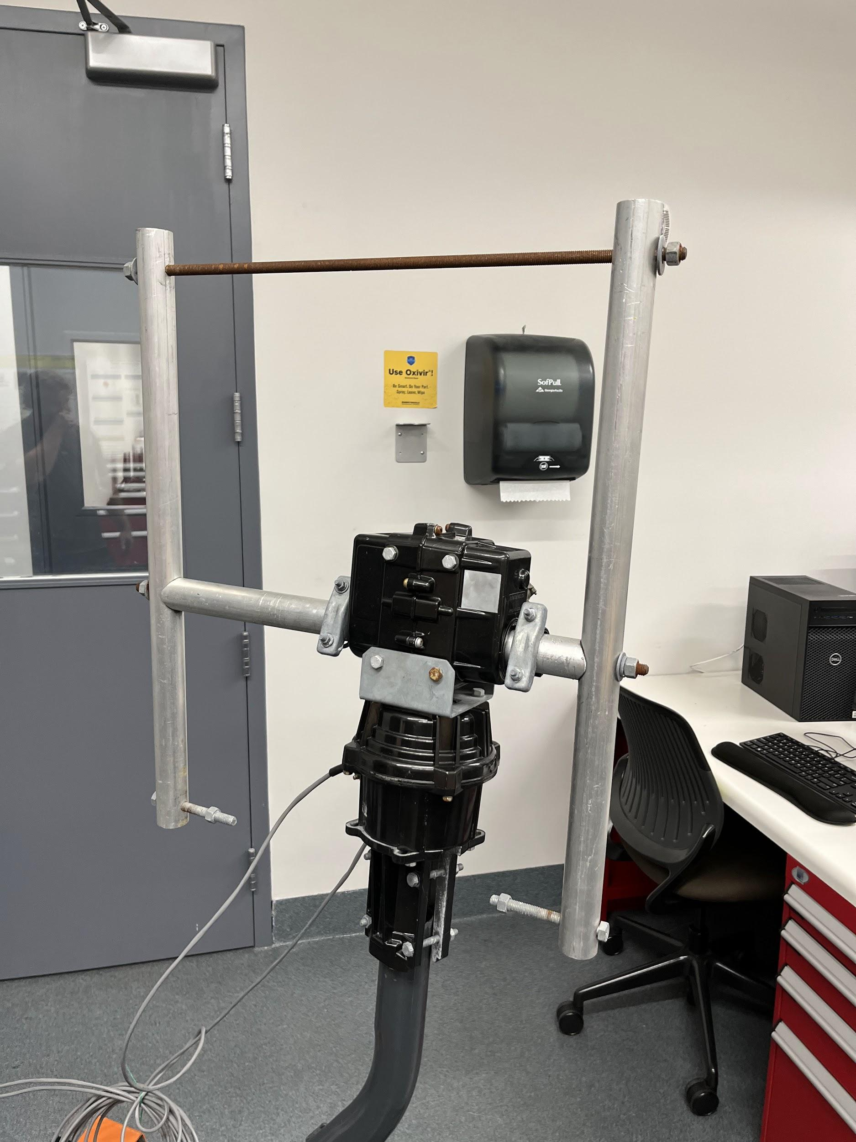
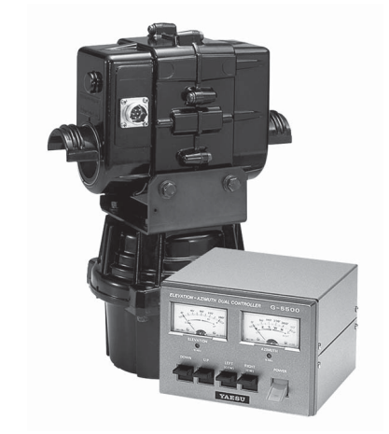
Positioner
G-5500
Key Features:
180° Elevation and 450° Azimuth rotations
The positioner is placed on a cart for mobile testing
Voltage requirement: 110-120 or 200-240 VAC
Motor voltage: 22 VDC
Rotation time (approx.): Elevation (180°): 65 sec. ± 20%
Azimuth (360°): 60 sec. ± 20%
Maximum continuous operation: 3 minutes
Azimuth: 40 kg-m (289 ft-lbs)
Vertical load: 200 kg (440 lbs)
Pointing accuracy: ±4 percent
Weight (approx.): Rotators: 8 kg (17.7 lbs)
Notes:
Lee

Slide 12
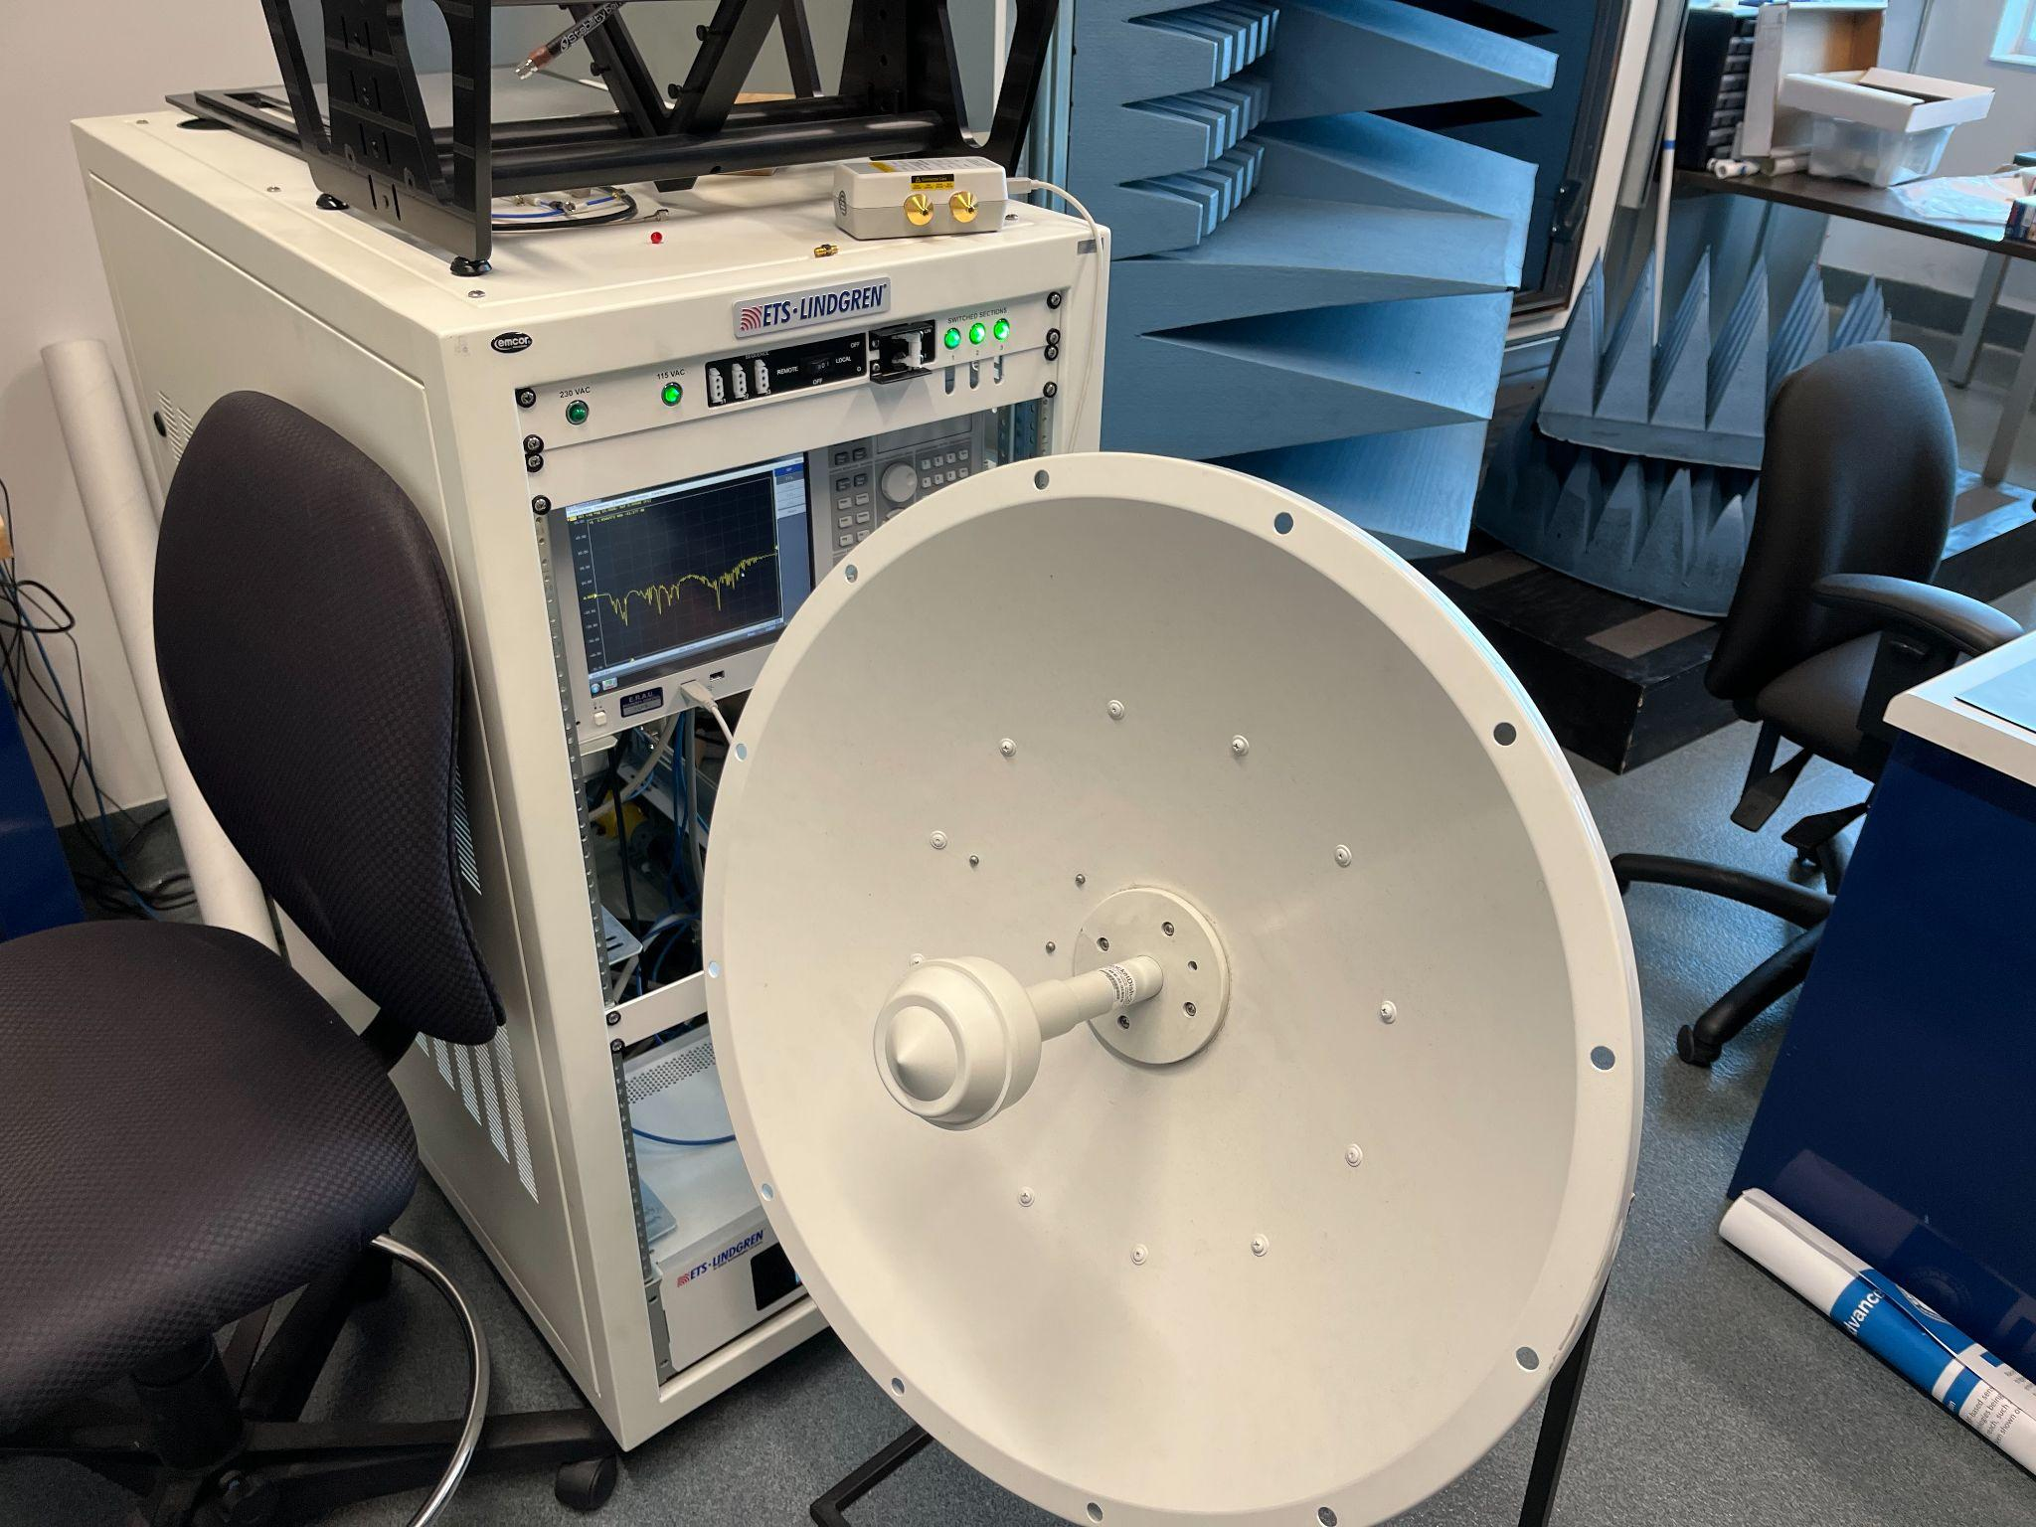
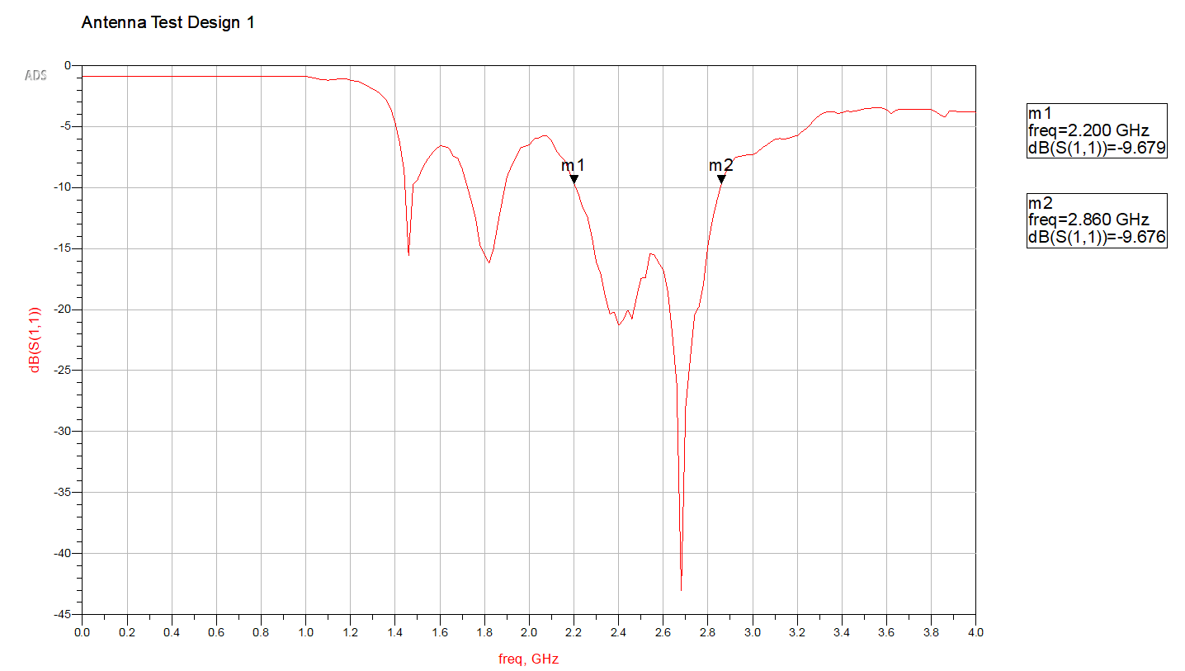
Antenna
Initial Design
Initial Test Data
Bandwidth = 660 MHz
Beamwidth = 3.38°
Notes:
JT

Slide 13
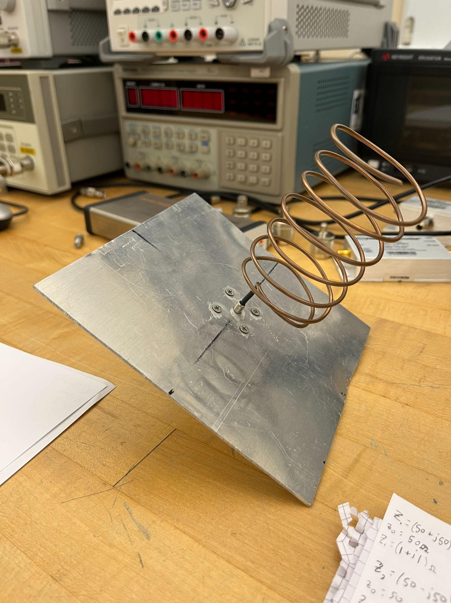
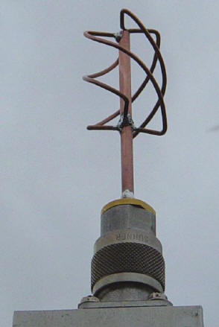
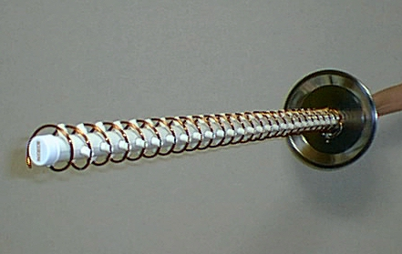
Antenna Alternative Designs
Notes:
s-band helix antenna - Bing
s-band helix antenna - Bing
JT

Slide 14

Base Structure

Slide 15
First Prototype Demonstration
Notes:
Lee & JT

Slide 16
Research Tasks Completed this Sprint
Doppler Frequency Shift Estimation for Satellites in Orbit
S-Band frequencies
Antenna Designs for S-Band at LEO and HEO
Matlab Script Written to Calculate the Sat. Position

Slide 17
Plans for Next Sprint
Software
Hardware
Radio
Translating Matlab Script from Matlab to Python
Begin to work on the GUI
Assemble the Databases and the function calls
Properly connect base station to cart
Attach counterweights to ground station frame
Securely fasten frame to actuating motors
Attach dish to frame (test)
Connect Yaesu GS-232A to GS-232 and personal computer
Define specific S-Band frequencies covered
Set GNU
Preliminary receiver testing
More formalized RF testing
Link Budget
Notes:
Carson - Software, Lee - Hardware, JT - Radio

Slide 18
Questions?

